Slide 1

Cassius Marcellus Clay Jr.
1942-1964

Slide 2
17 January 1942, Louisville, Kentucky, US..A).

Slide 3
Cassius Clay Jr. came from a predominantly African-American family. He grew up amidst racial segregation and was deeply affected by the brutal murder of Emmett Till in 1955. This event became a turning point in his fight for justice and equality.

Slide 4
he began training as an amateur boxer at age 12. At 18, he won a gold medal in the light heavyweight division at the 1960 Summer Olympics and turned professional later that year.

Slide 5
Clay made his professional debut on October 29, 1960, with a six-round decision over Tunney Hunsaker. From that time until the end of 1963, Clay had a record of 19–0, 15 of which were by knockout.

Slide 6
He joined to Islam after 1961. He won the world heavyweight championship by defeating Sonny Liston in a landslide on February 25, 1964, at the age of 22. That year, he rejected his birth name as a "slave name" and changed his name.

Slide 7
WHO ACTUALLY IS HE ?
The Greatest
The People's Champion

Slide 8
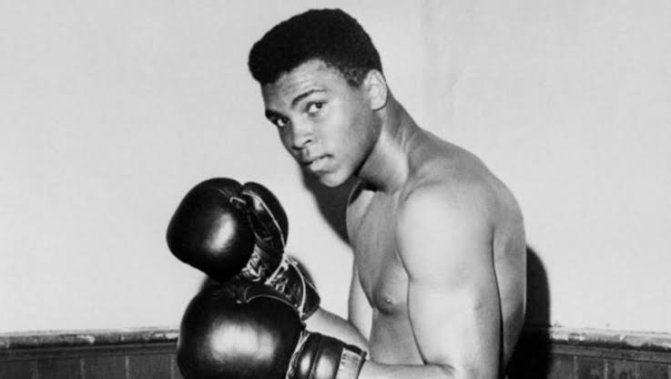
MUHAMMED ALI
1964-2016

Slide 9
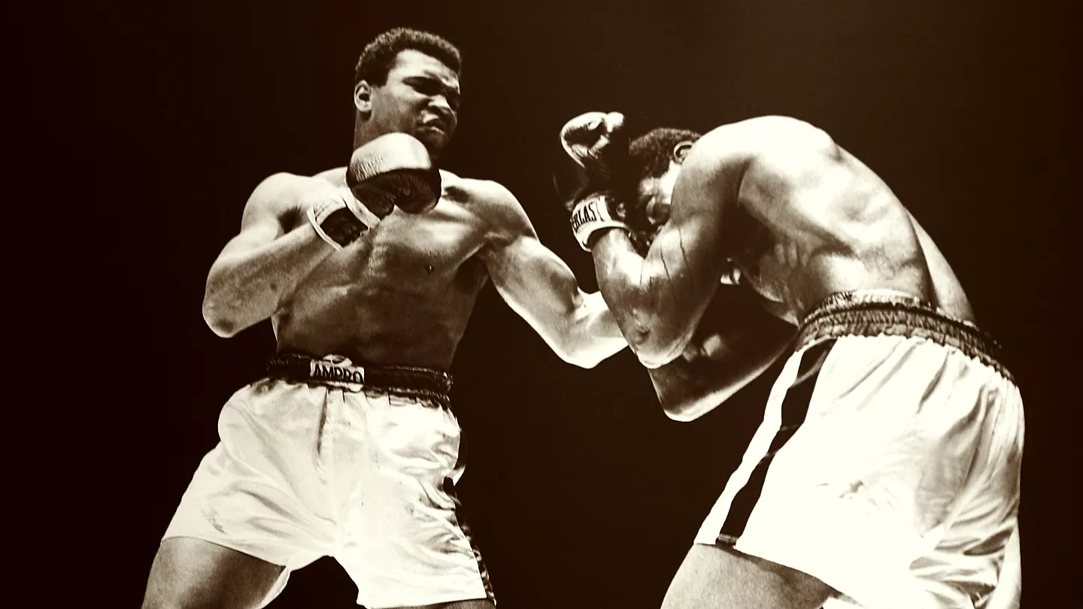
Tunney Hunsaker
1960

Slide 10
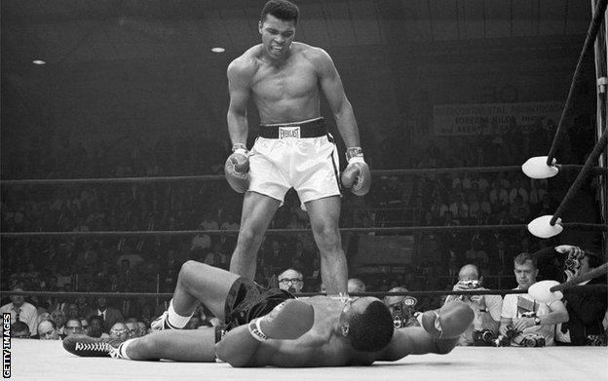
Sonny Liston
1964
"Fight of the Year"
by The Ring magazine.

Slide 11
Muhammad Ali refused to join the Vietnam War due to his religious beliefs and anti-war stance. Declaring himself a conscientious objector, he faced imprisonment and the suspension of his boxing license. After years of legal battles, his conviction was overturned by the Supreme Court in 1971. During this time, he became a powerful symbol of resistance against war and racism.

Slide 12
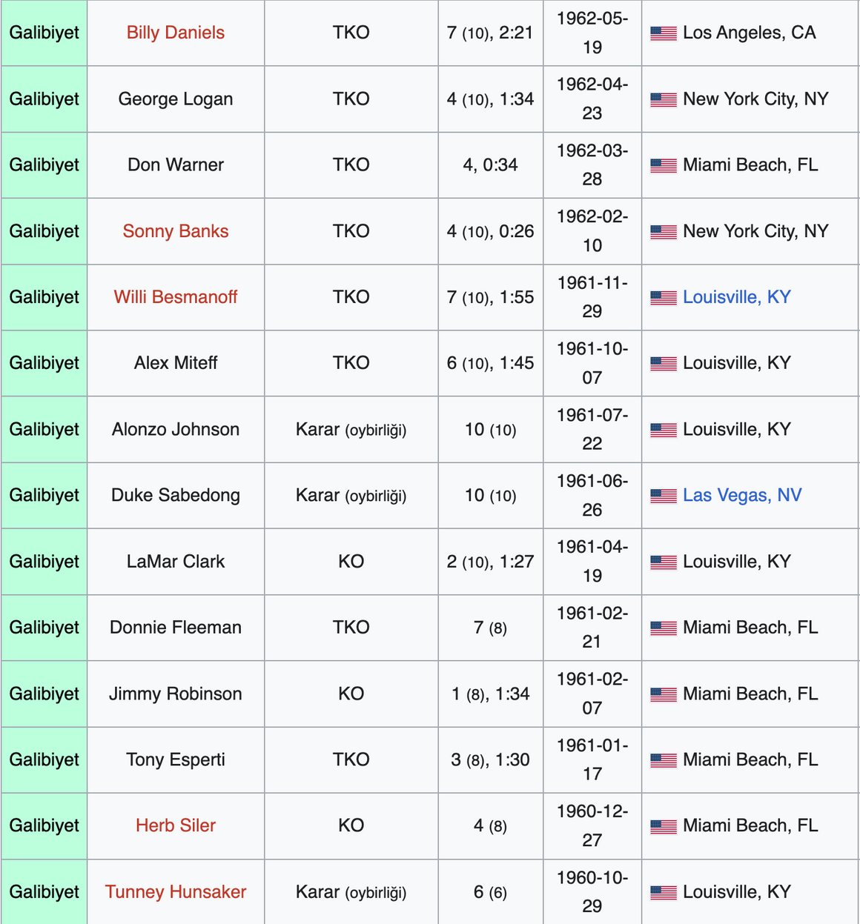
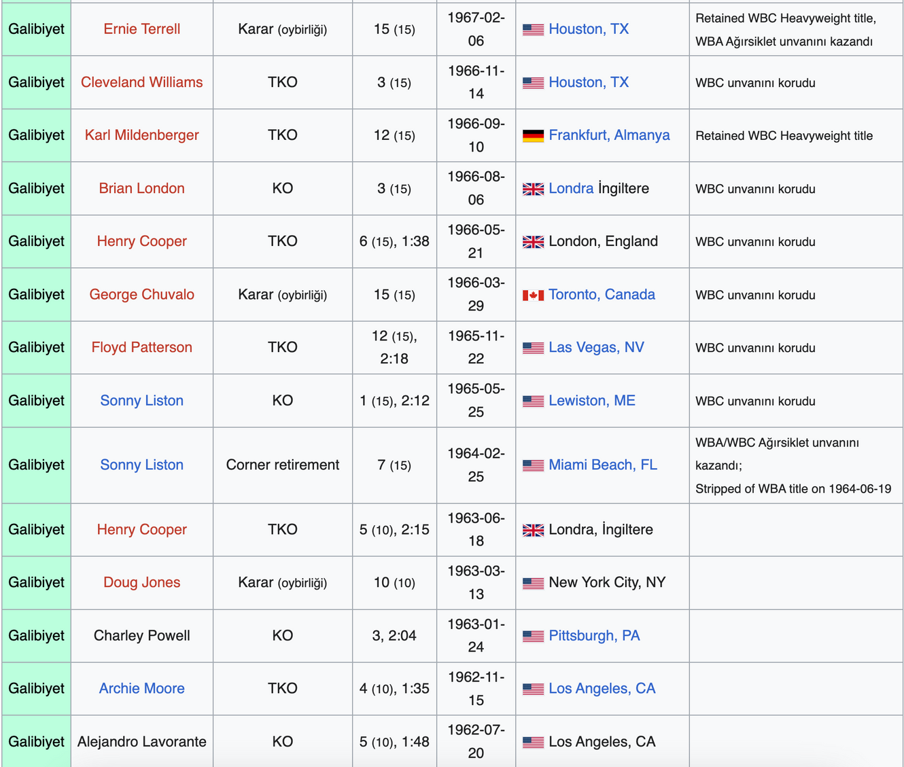

Slide 13
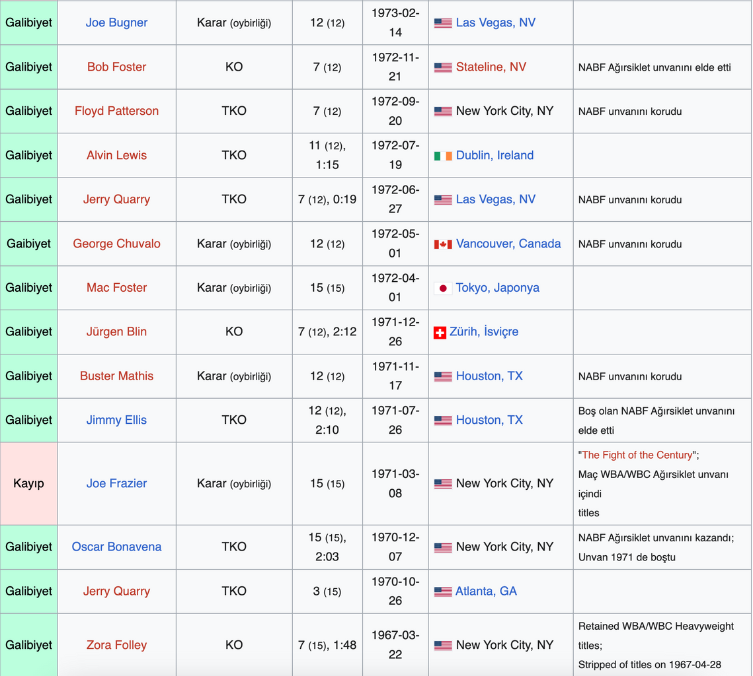
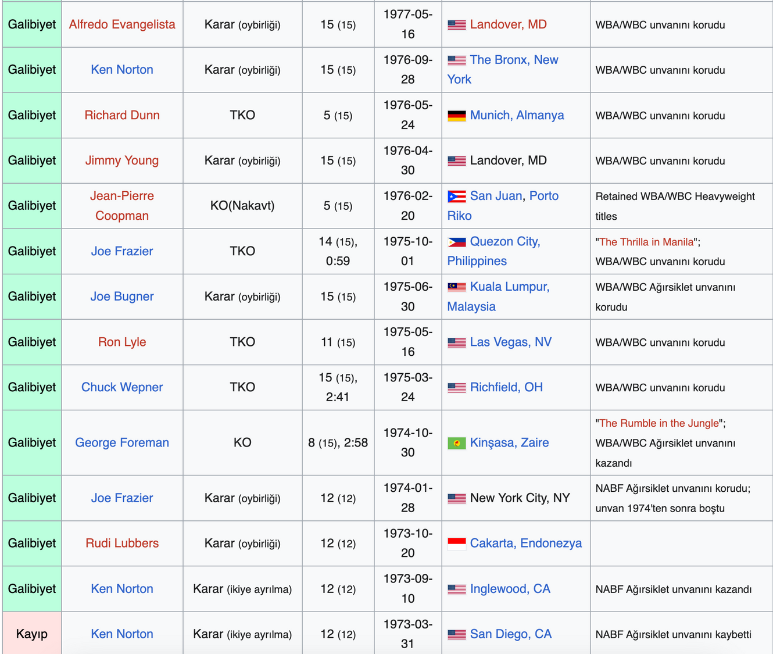

Slide 14
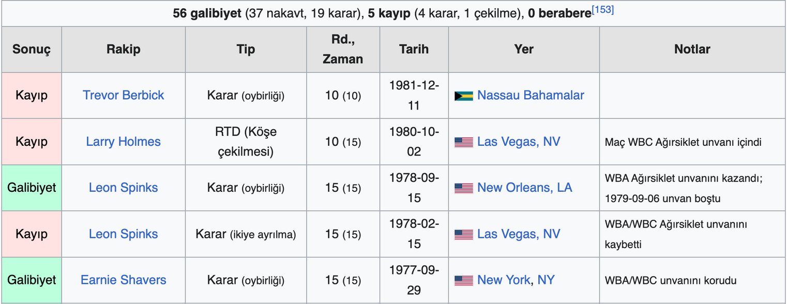

Slide 15
The final years of Muhammad Ali’s career were challenging as his aging body and health issues began to take their toll. In 1978, he defeated Leon Spinks to become the world heavyweight champion for the third time. However, in 1980, during a match against Larry Holmes, it became evident that he had lost his former speed and endurance. Holmes defeated Ali by technical knockout, marking the first time Ali lost by knockout in his career.

Slide 16
In 1981, Ali faced Trevor Berbick and lost again, after which he retired from boxing. He finished his career with an impressive record of 56 wins (37 by knockout) and only 5 losses.
After retiring, Ali battled Parkinson’s syndrome, a condition believed to be a result of his long boxing career. Despite his illness, he remained active in social and humanitarian causes and became a global ambassador for peace. Ali passed away in 2016 at the age of 74.

Slide 17


Slide 19
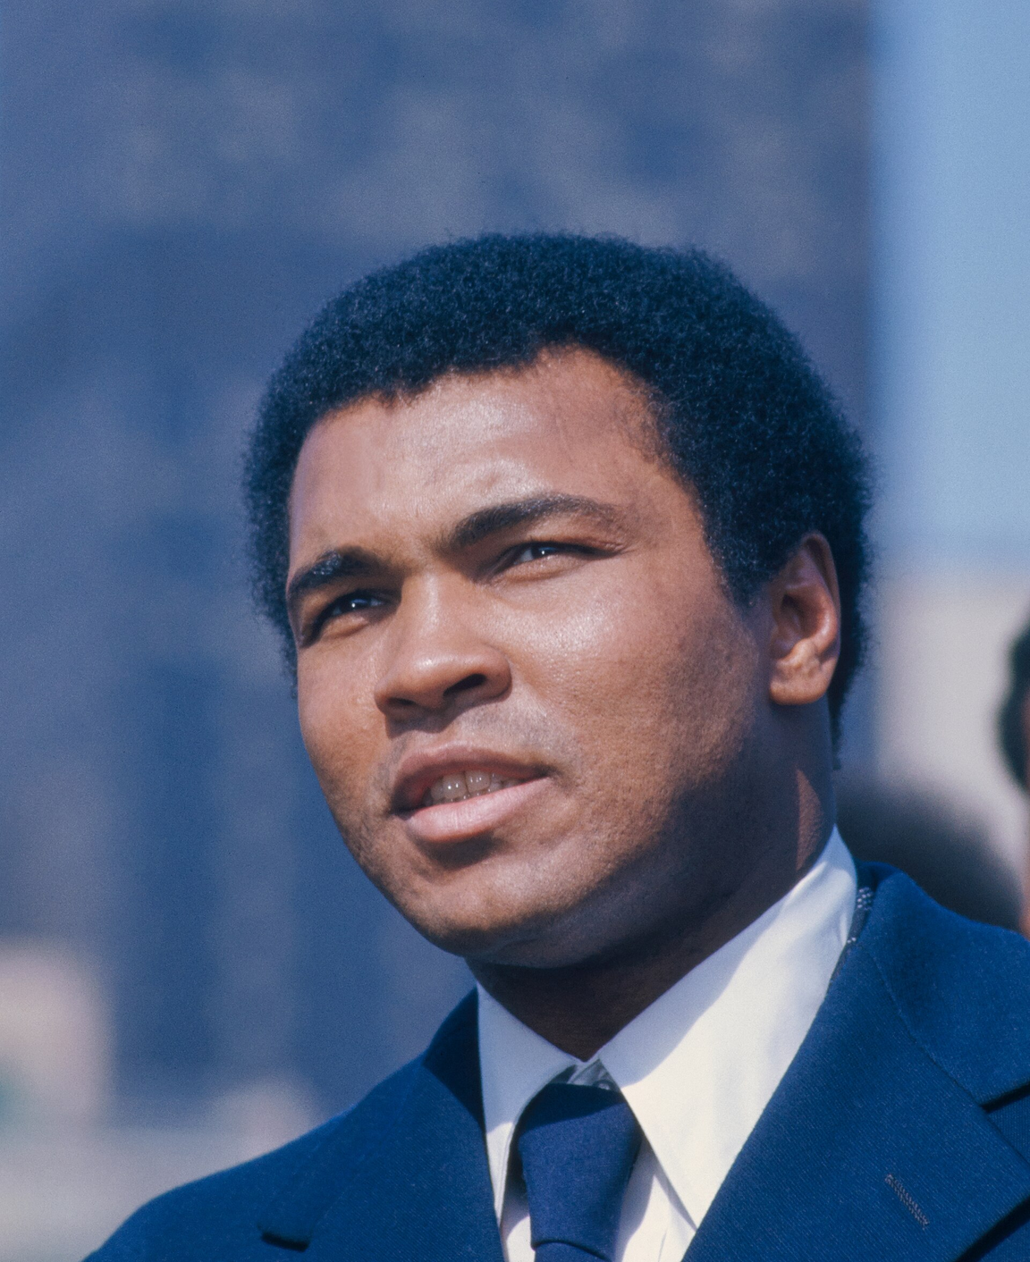

1942-2016

